Slide 1


KRAKEN QGIS PLUGIN • USER MANUAL
Load Analysis
Automated dual-engine framework analyzing DL PRB Utilization and DL User Throughput to deliver precision Vertical (Cosector) and Horizontal (Inter-site) load balancing targets.
Vertical Engine
Horizontal Engine
Pie-Wedge Geometry
Cosector MLB & Coverage Balance
Multi-Tier Spatial Scoring
60° Beam Intersection Overlap
Kraken © 2026 | akanipatra@gmail.com

Slide 2



STEP 01 • SYSTEM ARCHITECTURE
Core Workflow
Dual Analysis Pipeline Overview
1. Column Mapping Engine
2. Vertical Load Engine
3. Horizontal Load Engine
Resolves user fields via SettingDialog. Extracted without hardcoded aliases across QgsFeature, Pandas Series, and dictionary structures.
Evaluates co-sector cells on the same site. Identifies high PRB utilization (>80%) and checks load acceptance against band LTC throughput thresholds.
Filters different site towers matching frequency band. Executes spatial cone filtering (45°) and ranks inter-site targets using composite scoring.
Safe Parsing: Handles NULL, N/A, and comma decimals
Outputs: MLB adjustment or Coverage Balancing
Top 5 Inter-Site Candidates Ranking
Kraken © 2026 | akanipatra@gmail.com

Slide 3
STEP 02 • VERTICAL ANALYSIS
Threshold PRB > 80%
Cosector Load Balancing Rules
Trigger 01: High PRB Cell Detection
Identifies cells with PRB utilization exceeding 80%. Flags severe congestion when PRB exceeds 90%.
ACTION RECOMMENDATION MATRIX
TA90 Ratio | Condition | Recommended Action
< 0.7 | Target coverage shorter | Coverage Balancing
> 1.3 | Target coverage larger | Check MLB Parameter
0.7 - 1.3 | Similar coverage profile | Adjust MLB Target
Trigger 02: Candidate Acceptor Validation
Target cell must satisfy: PRB delta > 30% and throughput meeting/exceeding band LTC threshold.
Trigger 03: Automated Action Logic
Evaluates TA90 coverage ratio between high load cell and acceptor candidate:
Kraken © 2026 | akanipatra@gmail.com

Slide 4
STEP 03 • HORIZONTAL ANALYSIS
Co-Band Inter-Site Filtering
Spatial Cone Search & Iterative Stages
STAGE 1
Radius ≤ 2.0 km
STAGE 2
Radius ≤ 5.0 km
STAGE 3
Radius ≤ 10.0 km
inter-site_2Km_90degree
inter-site_5Km_90degree
inter-site_10Km_90degree
Primary dense urban offloading radius inside 45° angle cone.
Suburban expansion search if Stage 1 yields zero candidates.
Macro rural fallback boundary for distant neighbor search.
CANDIDATE RANKING MODEL
40%
40%
20%
Total Score Formula
+
+
Weighted composite scoring evaluates sector alignment, distance proximity, and coverage overlap.
Intersection Overlap
Face-to-Face Alignment
Distance Score
60° Pie-wedge Area Ratio
Cos²(d_A) × Cos²(d_B)
Proximity Buffer Scaling
Kraken © 2026 | akanipatra@gmail.com

Slide 5

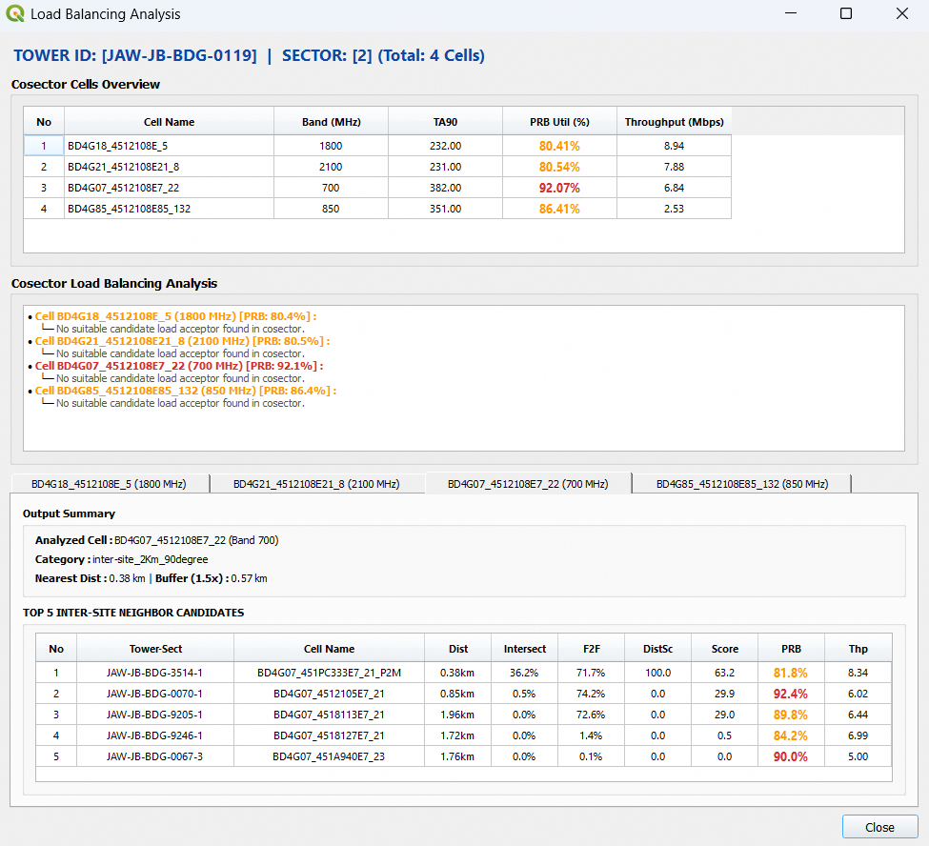
STEP 04 • USER INTERFACE & OUTPUT
GUI Execution View
Load Balancing Analysis Results Window
1. Cosector Cells Overview
Displays all carrier bands in the sector with TA90, PRB Util (%), and Throughput (Mbps) highlighted by load color codes.
2. Cosector Load Remarks
Automated diagnostic messages advising whether to adjust MLB parameters or initiate coverage balancing per cell.
3. Top 5 Inter-Site Candidates
Ranked list showing Distance, Beam Intersect (%), F2F Alignment (%), DistScore, Total Score, target PRB, and Throughput.
Kraken © 2026 | akanipatra@gmail.com

